Slide 1




Customer Lifetime Value’s Review of a Lifetime
August 2022
Tatiana Tikhonova
Data Scientist, Sense360 by Medallia

Slide 2






About
9:01 AM
Works out at local gym
11:15 AM
Stock-up
$110.26
Smartphone Movement Data
8:32 AM
Breakfast on the run
$16.99
1:36 PM
Orders lunch for pickup
$12.26
SURVEY
Why did you choose to visit Target?
Credit/Debit Spend Data
Opinion Data

Slide 3

1
What and Why

Slide 4
1
What and Why
2
Common pitfalls

Slide 5
1
What and Why
2
Common pitfalls
3
Practical methodologies

Slide 6
Customer Lifetime Value (CLTV, CLV, or LTV)
Customer
Lifetime
Value

Slide 7
What is the value of the LTV?
LTV is nothing but a number until applied to the decision-making process.

Slide 8
Credit: https://business2community.com
Avg Net Sales per Month = $100
Avg Customer Lifespan = 6 months
Margin = 30%
Discount rate = 12%
Retention rate = 80%
$180 X (0.80 / (1+ (0.12 – 0.8)) = $180 X (0.80/0.32) = $450.

Slide 9
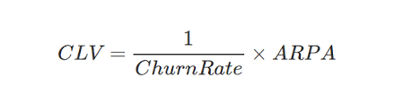
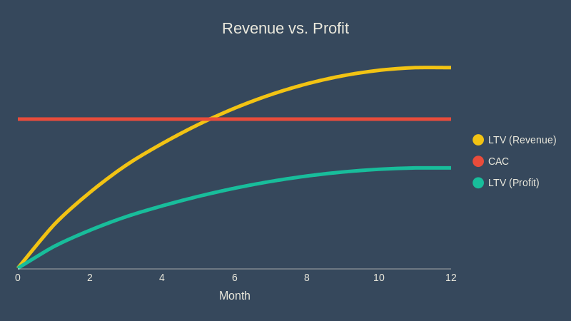
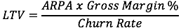


Disregarding Margin
Credit: Danny Feinberg

Slide 10
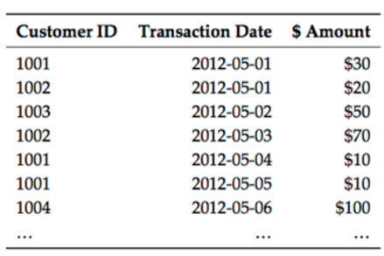
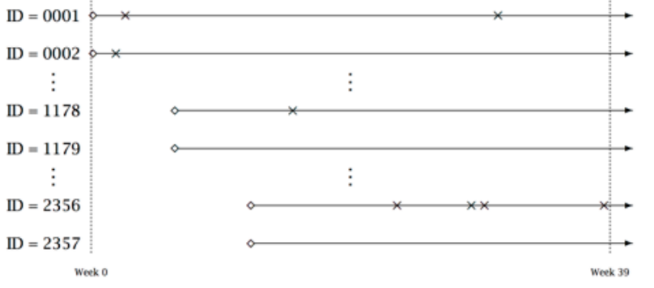
Incorrect base inputs + lack of segmentation
Credit: Roberto Medri

Slide 11

OVERstating Projected Lifetime
Hard to estimate customer lifetime when you are a startup → OK to guess but keep it reasonable

Slide 12
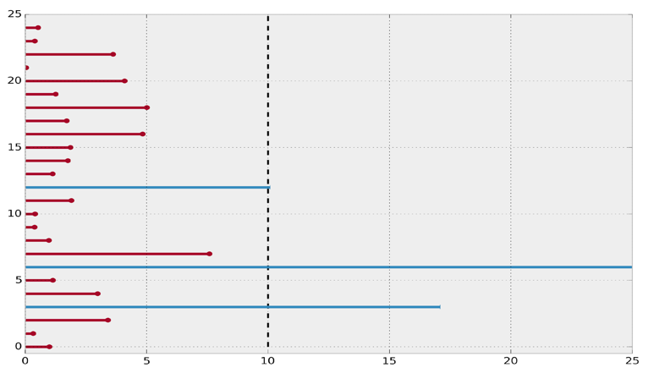
UNDERstating Projected Lifetime
Using 1/Churn estimation and considering everybody churned as of now, can both lead to a huge understatement.
Credit: Python ‘lifelines’ documentation

Slide 13
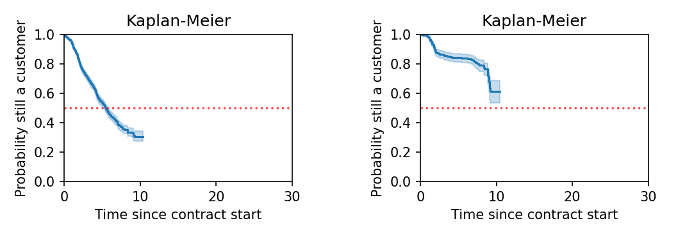
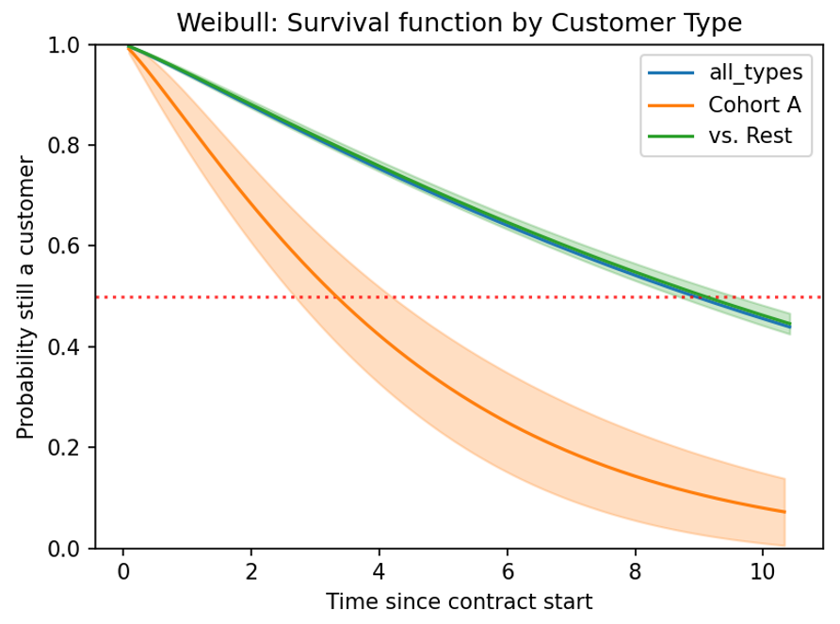
Survival Analysis

Slide 14
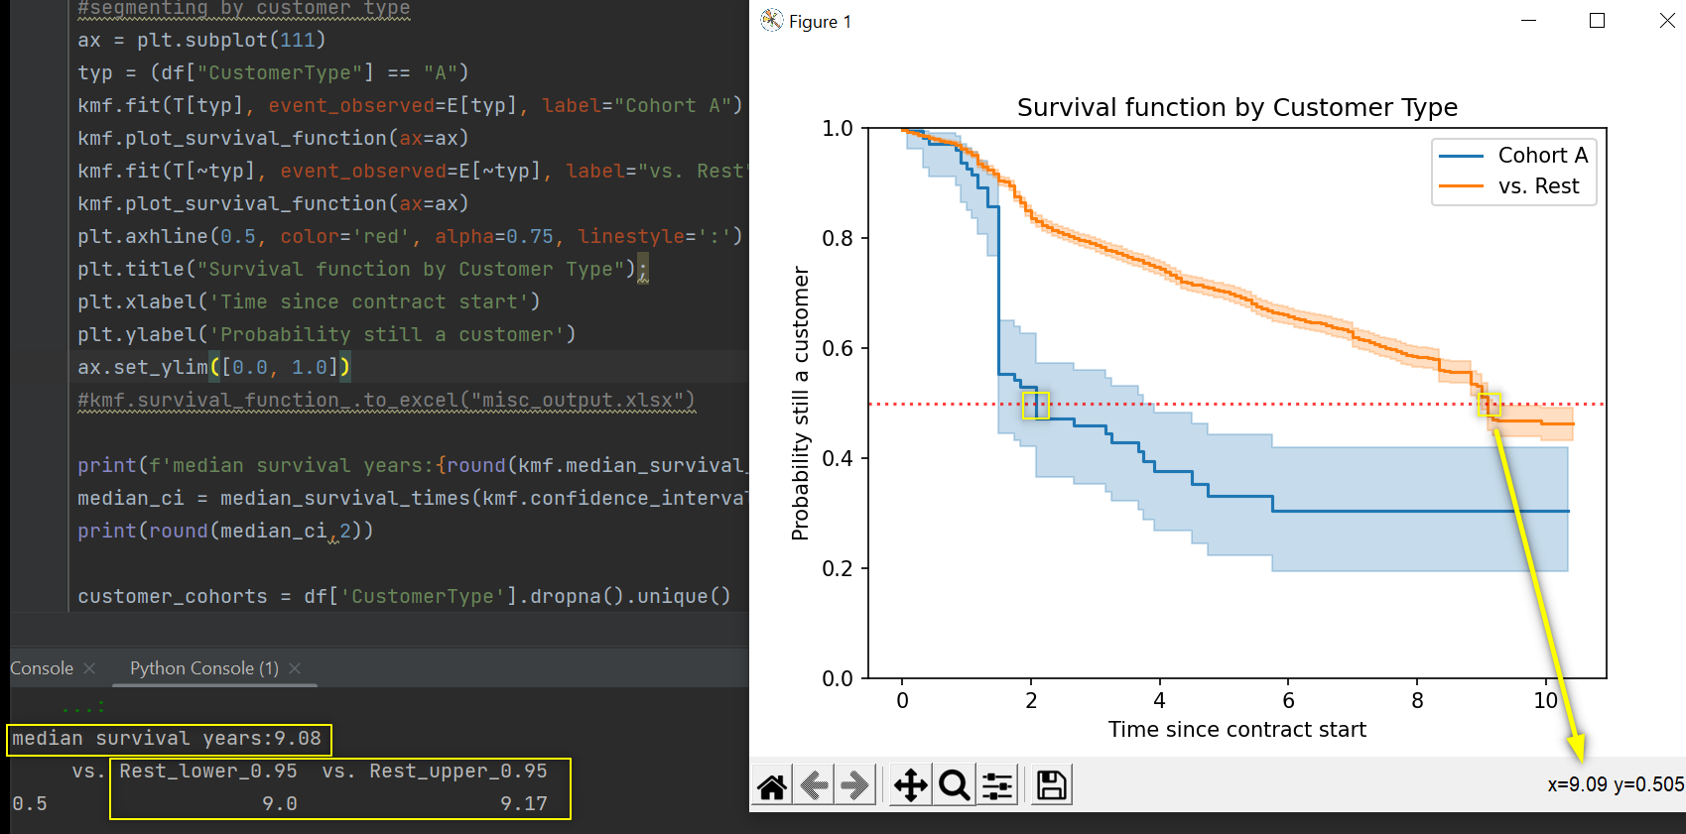
Probabilistic model: Survival Analysis

Slide 15
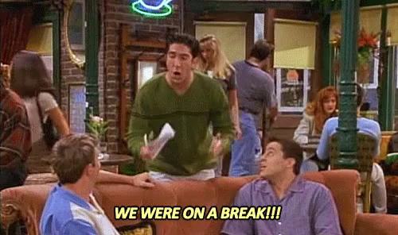
CLTV
Contractual
(observe time of churn)
Non-Contractual
(time of churn is unobserved:
client gone or taking a break?)

Slide 16
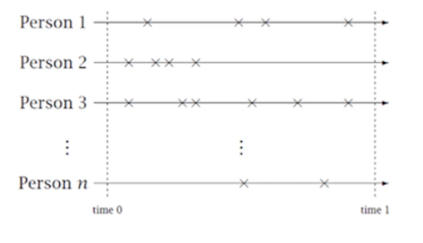
Non-Contractual: main challenges
Non-observable purchasing rate
Hard to understand when churned
Purchasing rate & dropout propensity vary
Credit: Peter Fader

Slide 17
Whose LTV is likely higher?
today
#1
#2
“
Increasing Frequency Paradox
For low frequency customers, there is an almost linear relationship between recency and [expected transactions]. However, this relationship becomes highly nonlinear for high frequency customers.
- Peter Fader/Bruce Hardie/Ka Lok Lee

Slide 18
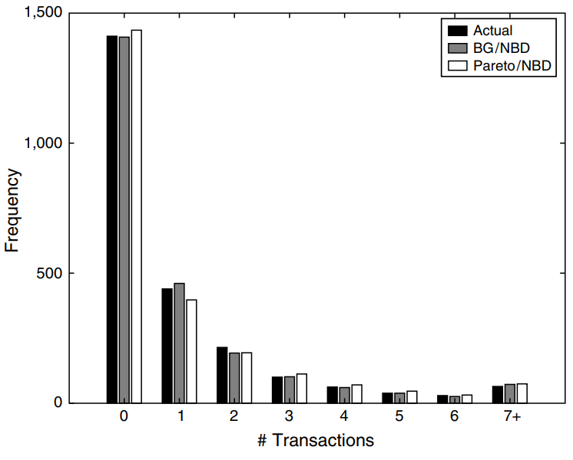
Buy ‘Till You Die
- Pareto / Negative Binomial Distribution, 1987
- Beta Geometric / Negative Binomial Distribution, 2005
Credit: Fader/Hardie/Lee

Slide 19
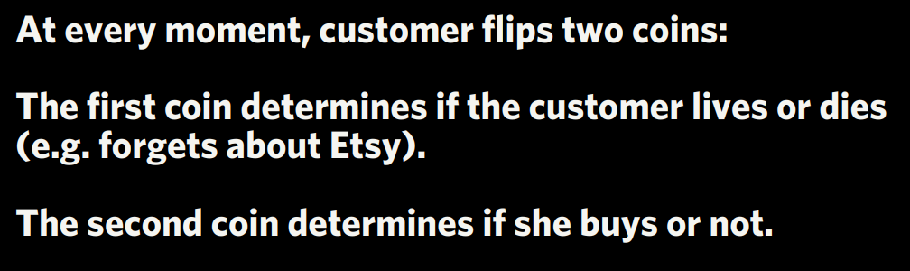
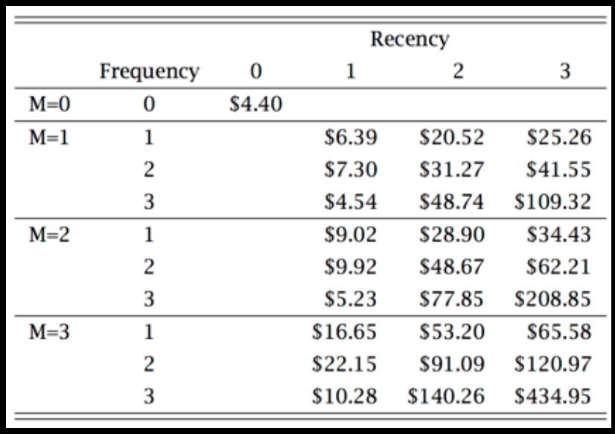
Etsy’s approach
Credit: Roberto Medri

Slide 20
Resources
http://github.com/tikhonova
http://brucehardie.com/papers/rfm_clv_2005-02-16.pdf
http://www.brucehardie.com/papers/020/fader_et_al_mksc_10.pdf
https://brucehardie.com/notes/004/
https://www.youtube.com/watch?v=guj2gVEEx4s
http://cdn.oreillystatic.com/en/assets/1/event/85/Case%20Study_%20What_s%20a%20Customer%20Worth_%20Presentation.pdf
https://www.linkedin.com/pulse/customer-lifetime-value-ltv-part-3-common-mistakes-risks-reynolds/
https://www.arcalea.com/blog/calculating-lifetime-value-ltv
https://medium.com/tradecraft-traction/4-mistakes-to-avoid-when-calculating-ltv-1ade13f90ec9
https://github.com/CamDavidsonPilon/lifetimes
https://en.wikipedia.org/wiki/Buy_Till_you_Die
https://www.business2community.com/customer-experience/4-ways-to-measure-the-lifetime-value-of-your-customers-02338898
https://blog.fusebill.com/2014/08/12/customer-lifetime-value
http://brucehardie.com/papers/018/fader_et_al_mksc_05.pdf
https://lifelines.readthedocs.io/en/latest/Survival%20Analysis%20intro.html
https://boostedml.com/2018/11/when-should-you-use-non-parametric-parametric-and-semi-parametric-survival-analysis.html

Slide 21
Questions? Contact me:
ttikhonova@medallia.com github.com/tikhonova
linkedin.com/in/tatianatikhonova
Tatiana Tikhonova
Data Scientist, Sense360 by Medallia

